Slide 1
SIERRA LIQUIDATION STORE
This is an ecommerce store that has android and iOS mobile apps to help in meeting the business requirements

Slide 2
SIERRA ECOMMERCE WEBSITE
This is an online store bundles with various features which is created and developed in woo commerce platform. There is initial subscription to ensure the website is live, however the store owner should plan to subscribe for yearly utilization of maximum features of the platform. The sierra liquidation store support display of products in various categories which provide users with easy access.

Slide 3
Website features
The website support various functions which include:
1. Online shopping
2. Shipment of products
3. Ordering of products
4. Online payment majorly PayPal
5. Usage of Square and internal Point of sale to capture information into a .csv file which is used to update products store.
6. sign up and registration of customers
7. Customer support service
8.intergration of online store management app that enables store owner to manage business activities at his/ her comfort.

Slide 4
App features
There are two types of apps associated with this project back-end store management app and the customer app.
The store management app is the backend mobile module of the website that enables the owner to manage various activities such as order, products, shipment, invoices among others remotely without logging into the website.
The customer app enables consumers to shop for various products, make inquiries, contact the store, register for services alongside other user requirements.

Slide 5
Other features requiring configurations
The payment gateway for PayPal should be configured using owner’s business PayPal and eventually link the card.
There should linking of Square API and Point of sale in the website to support transfer of products content and other information available updates effectively.
The website has a blogging feature that enables the store to run various promotional blogs to increase sales.

Slide 6
Technical features
The website enables the store to run and configure various online marketing activities
It support business analytics that is a tool that enables the store to gather customer preferences and rate the final performance of the business.
The channel manager enables the business owner to sell in other online platforms such as eBay, amazon and even big commerce. The integration process of unlocking these features requires clients confidential information and it is of preference the he/she should be assisted by a closer individual.

Slide 7
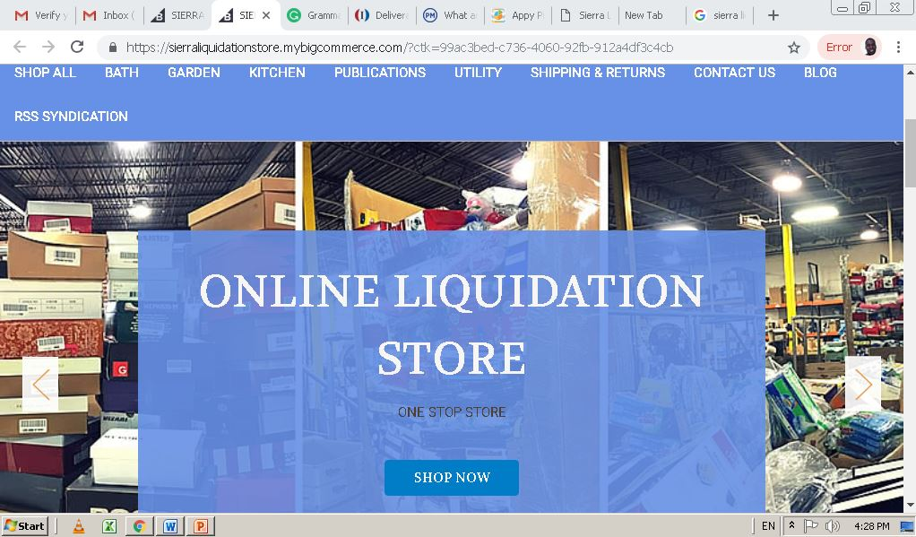
Screenshots from website platform

Slide 8
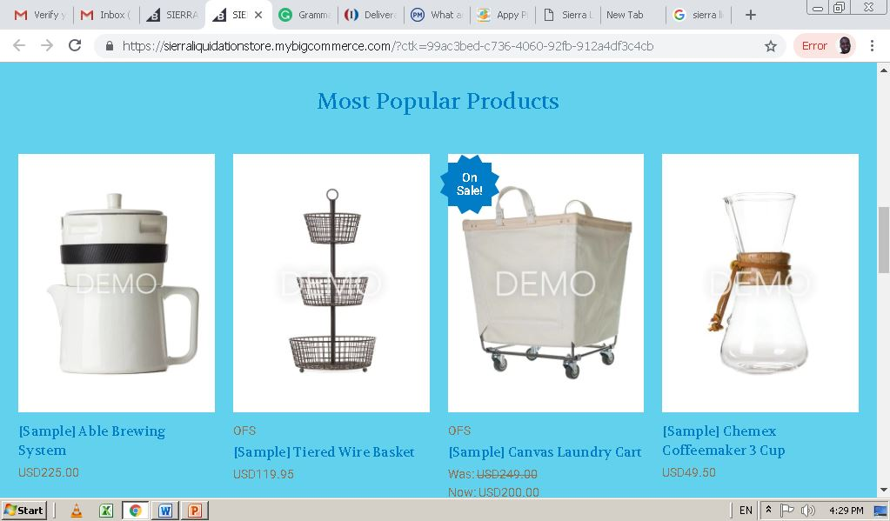

Slide 9
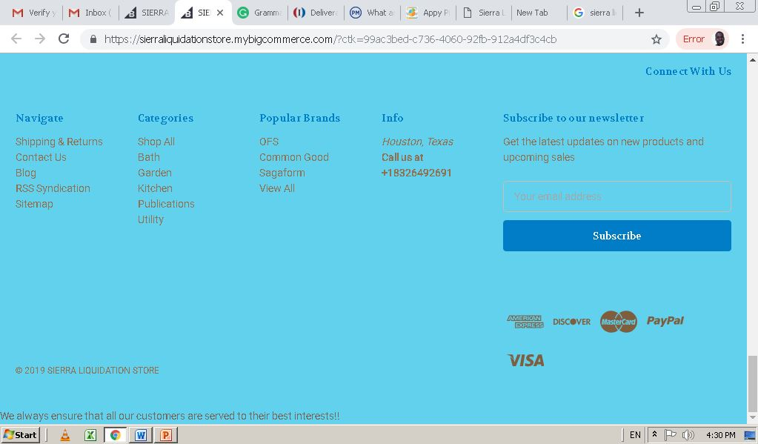

Slide 10
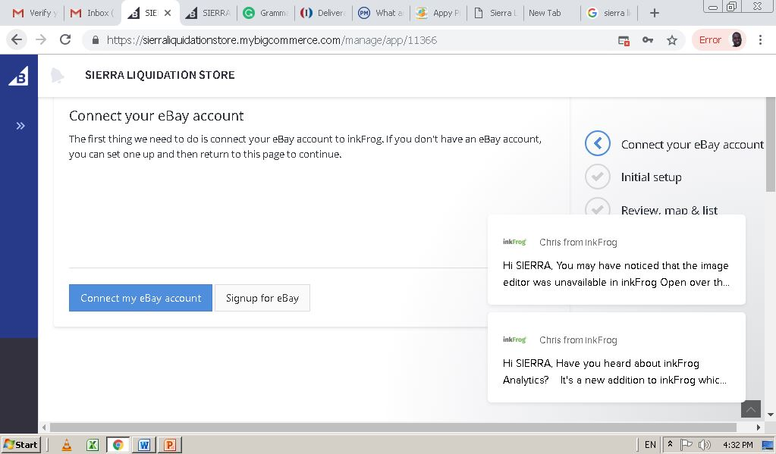
Screenshots from developer platform Linking to eBay for sales

Slide 11
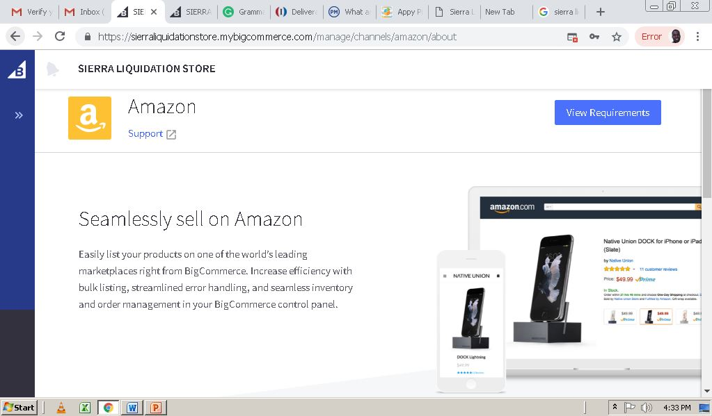
Linking to amazon for sales

Slide 12
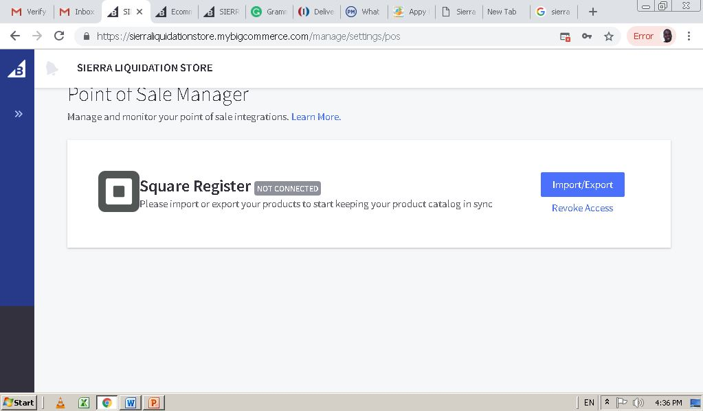
Linking Point of sale to Square register to enable automatic store products update.
Notes:
The Point of sale will capture information that has been recorded in square register platform that interfaces barcode scanning. The information captured by the Square register API is automatically synced to point of sale. This will enable automatic updating of store product information in the system

Slide 13
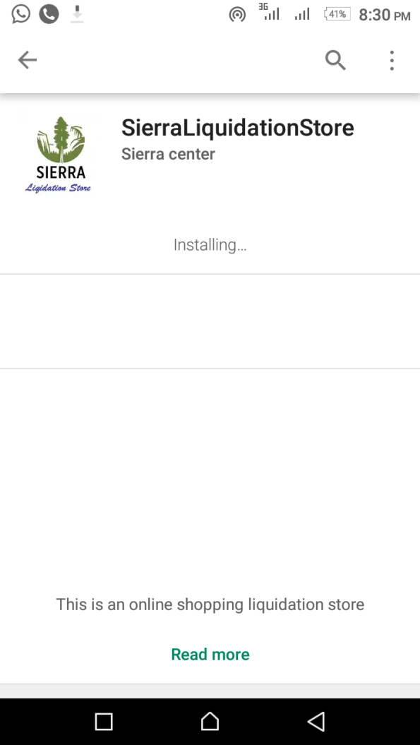
App Screenshots

Slide 14
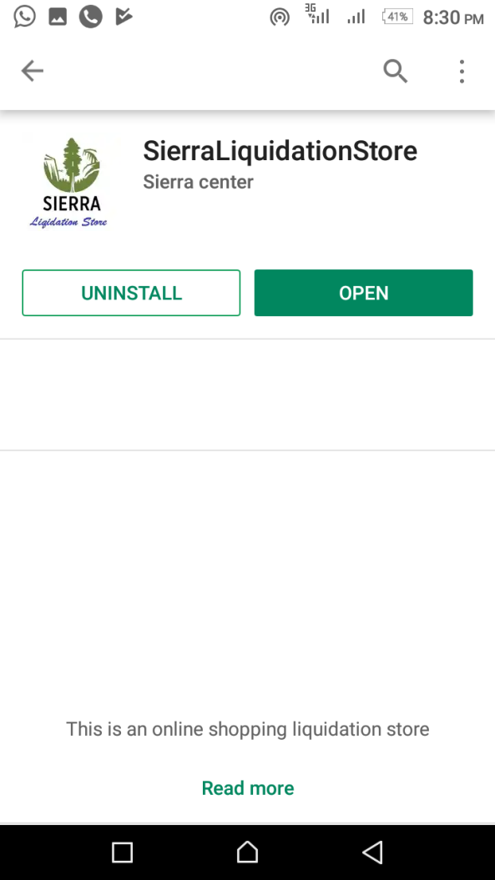

Slide 15
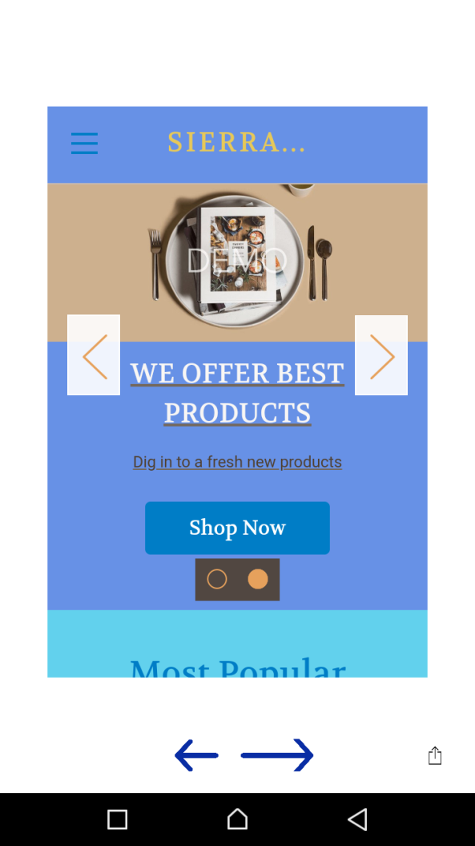

Slide 16
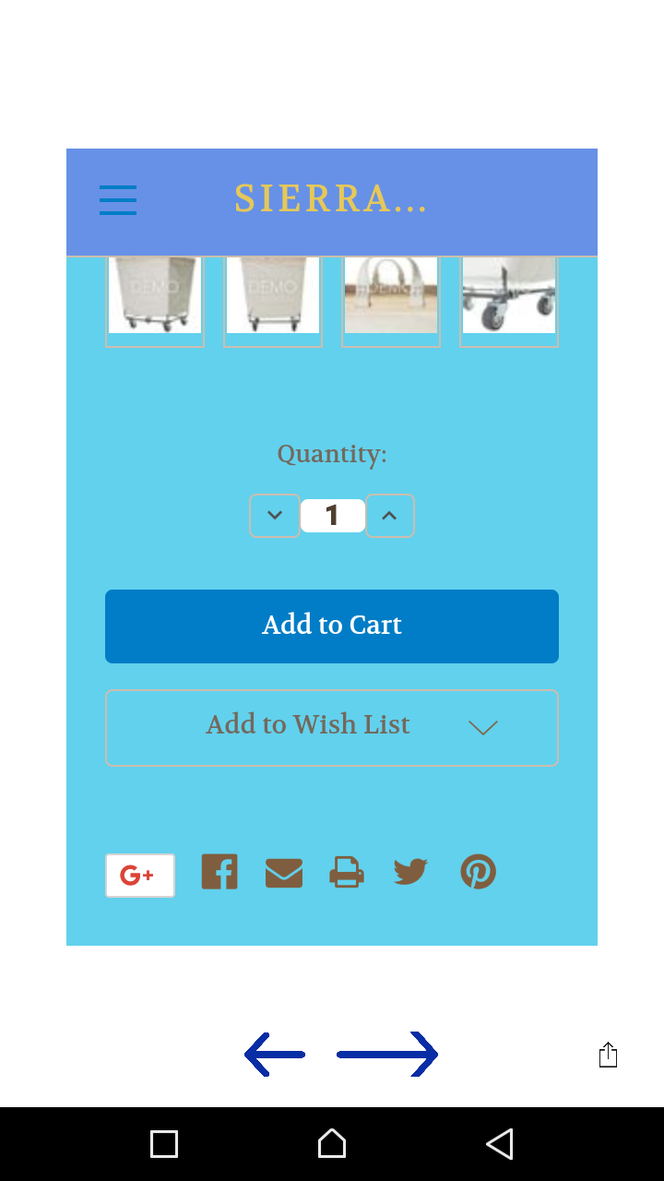

Slide 17
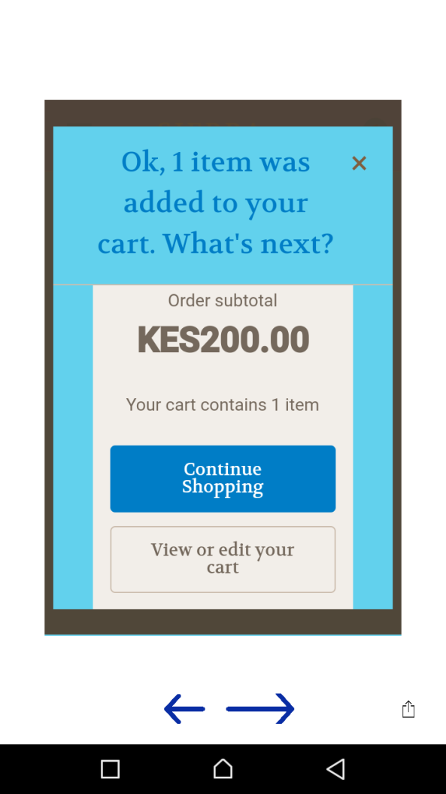

Slide 18
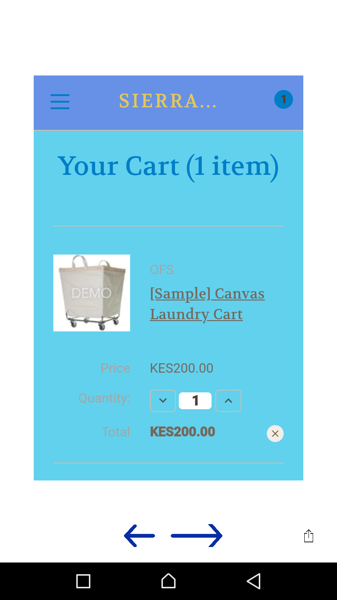

Slide 19
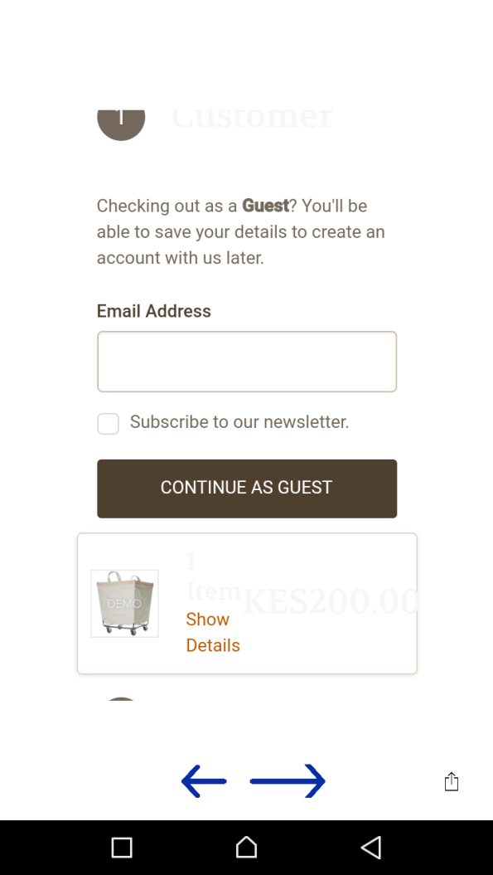

Slide 20
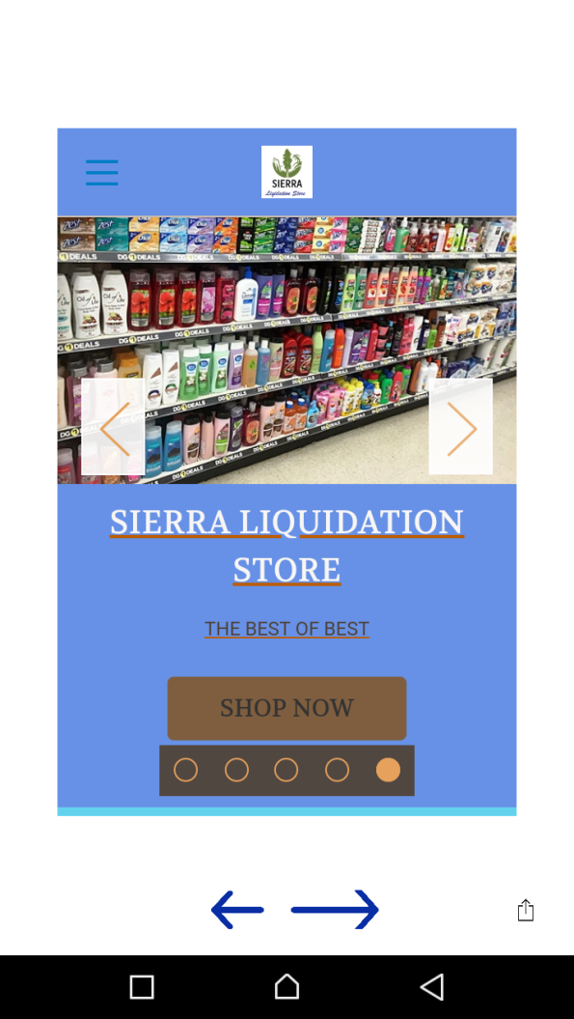

Slide 21
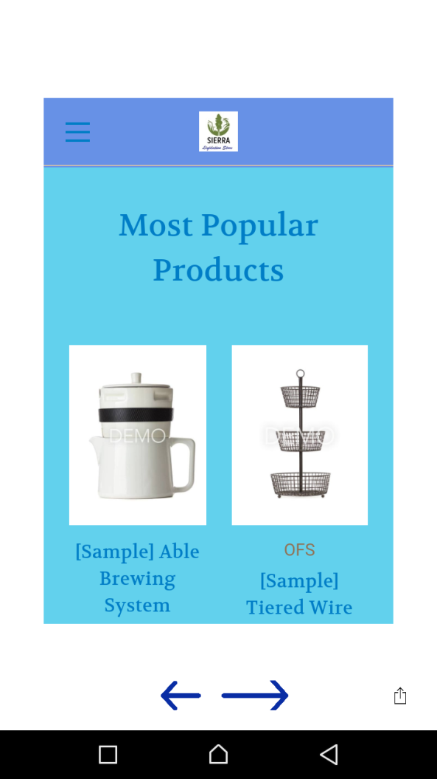

Slide 22
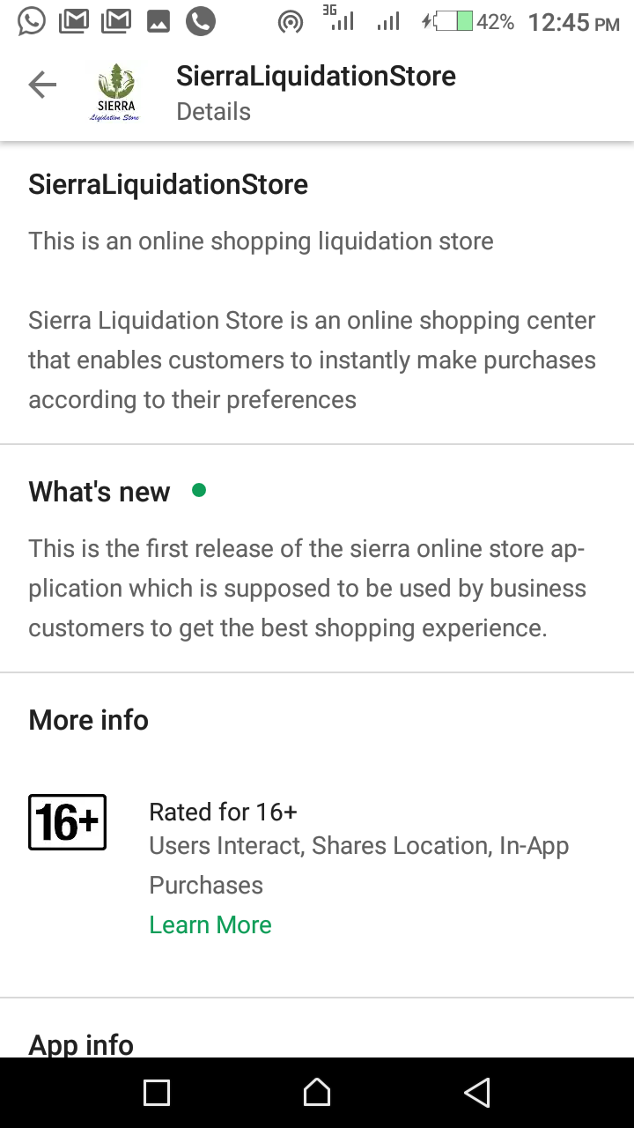

Slide 23
The few previous screenshots demonstrate process of product purchase. The platform used to build the ecommerce website provides various features that are accessed through subscriptions.
It is important to configure the store payment gateway to business PayPal and eventually incorporate other payment forms. Activation and linking of payment gateway is accessed in the developer platform under “payment settings”.
It is also important to access the mobile store manager which comes with customer configurations for your phone. The details such as API key, token and other details provided to you will assist in access and further configurations. It is a great experience to manage your store from palm of your hands..
After final tuning of the system, products will be uploaded and business starts. Good luck and Thank you

